Slide 1
Title | Customer Segmentation & Market Basket Analysis for Online Retail II
Course | Intelligent Systems (MIS 6317)
Student | MUGASHA BLAISE BRADLEY
Reg. No. | 2024-M132-23976
.

Slide 2
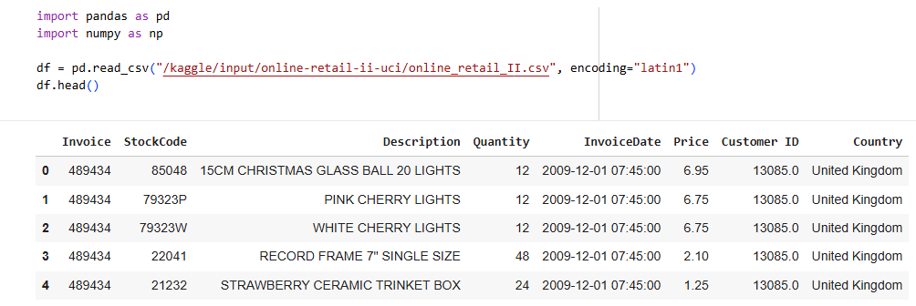
Dataset
About Dataset
Context
This Online Retail II data set contains all the transactions occurring for a UK-based and registered, non-store online retail between 01/12/2009 and 09/12/2011.The company mainly sells unique all-occasion gift-ware.
Many customers of the company are wholesalers.

Slide 3
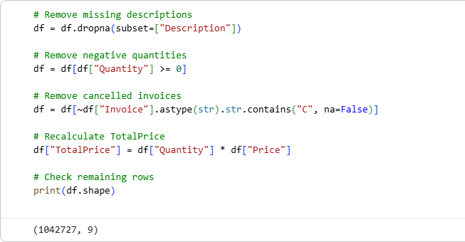
Project Overview & Data Preparation
Objective
To apply clustering (k-Means, Deep Embedding) and association rule mining (FP-Growth) to identify key customer segments and product relationships.
Data Cleaning & Feature Engineering

Slide 4
Customer Clustering Results (Part A & B)
Clustering Methods
Standard k-Means: Applied to standardized features, reduced by PCA.
Deep Embedding k-Means: Applied to 3D latent features extracted from a trained Autoencoder.
Key Finding: Cluster Quality
k-Means (on PCA): Silhouette Score = 0.9640.
k-Means (on Autoencoder Embeddings): Silhouette Score = 0.9679
Conclusion: The scores are very similar. The simple non-linear Autoencoder did not capture significantly more variance than the linear PCA, suggesting the core features have a close to linear relationship

Slide 5
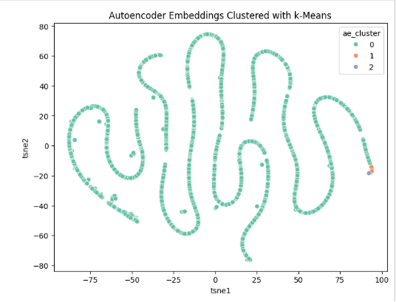
Autoencoder Embeddings Clustered with k-Means
The t-SNE visualization of the autoencoder embeddings shows that the latent space forms one dominant structure with minimal sub-cluster separation. Most customers fall into a single dense region, while the remaining two clusters contain only a small number of points. This indicates that the autoencoder did not reveal additional nonlinear patterns beyond the original features.

Slide 6
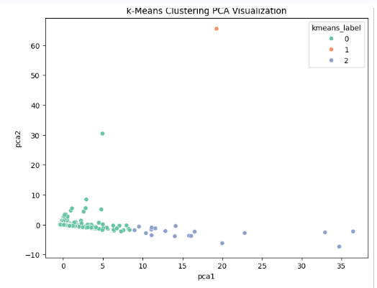
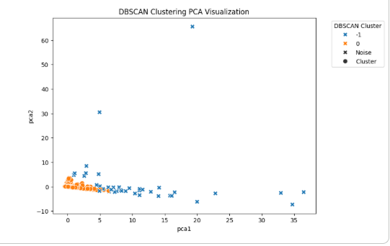
Cluster Visualization

Slide 7
Customer Segmentation
Cluster | Characteristics | Customer Type | Actionable Insight
Cluster 1 | High TotalSpending, High TransactionCount, Large AvgBasketSize | Premium/Wholesale-style buyers (High-Value) | Focus on Retention and Loyalty Programs.
Cluster 2 | Moderate spending, Moderate frequency and size | Typical Shoppers | Target with promotions to increase frequency/size.
Cluster 3 | Low spending, Few transactions, Small baskets | One-off buyers / Bargain Hunters (Low-Value) | Target with introductory offers to promote conversion to Cluster 2.

Slide 8
Association Rule Mining (Part C)
Method: FP-Growth
Rationale for FP-Growth: Used instead of Apriori because it avoids generating candidate itemsets, successfully handling the large search space of 5,368 unique items and preventing high memory consumption.
Parameters: min_support = 0.01; min_threshold (confidence) = 0.5.
Key Finding: POPPY'S PLAYHOUSE
The strongest rules are dominated by the "POPPY'S PLAYHOUSE" collection, revealing highly complementary product lines

Slide 9
Interpretation of Top Association Rules
Rank | Rule (IF → THEN) | Confidence | Lift | Business Action
1 | {Bedroom, Kitchen, Bathroom} → {Livingroom} | 73.43% | 52.45 | Use for "You Might Be Missing..." recommendations at checkout to complete the set.
3 | {Livingroom, Kitchen, Bathroom} → {Bedroom} | 86.29% | 49.45 | Use as a leading indicator. Send personalized emails promoting the Bedroom item immediately after the purchase of the other three.
7 | {Kitchen, Bedroom} → {Livingroom} | 81.74% | 46.84 | High confidence for a two-item antecedent. Ideal for immediate in-cart cross-selling to reliably increase basket value.

Slide 10
Actionable Business Recommendations
Retention Strategy for High-Value Customers (Cluster 1)
Action: Implement exclusive, tiered loyalty programs.
Goal: Increase retention rate and Share of Wallet by rewarding their high-volume behaviour
Optimize Cross-Selling (POPPY'S PLAYHOUSE)
Action: Power a "Customers Who Bought This Also Bought " engine with rules having a high Lift score (e.g., > 15)
In-Store: Strategically place strongly associated items (e.g., Bedroom and Kitchen) near each other to encourage impulse buying

Slide 11
Actionable Business Recommendations Cont’d
Convert Occasional Buyers (Cluster 3)
Action: Develop targeted "Welcome Back" campaigns with small, attractive discount incentives.
Goal: Shift these low-value customers towards the Medium-Value, Regular Buyers (Cluster 2) profile

